Slide 1


Introduction to Azure Data Factory
https://github.com/MarcusMLarsson/Azure-Data-Factory-Demo
Marcus Larsson
Wednesday, 17 June 2020

Slide 2

What is Azure Data Factory (ADF)?
ADF is a cloud ETL and data integration tool
ADF enables you to quickly and efficiently create automated data pipelines
without having to write any or little amount of code!

Slide 3

What can you do with Azure Data Factory?
Azure Data Factory can be used to ingest and transform data.
You can ingest data from ¹
On-premises data stores
Cloud data stores
SaaS applications
You can convert file formats, zip and unzip files, and map columns– all in one task.
See link for supported data stores and file formats

Slide 4
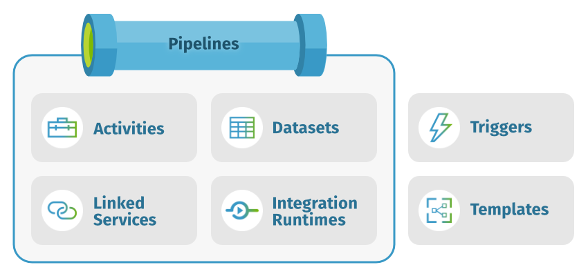
A deeper dive into Azure Data Factory

Slide 5


ADF - Cloud ETL
SSIS - On-premise ETL
Medium volume of data
High Volume of data
Batch
Batch & Streaming
Structured
Structured, unstructured & schema-drift
On-premises, own hardware, scale out
Hybrid, managed, scale up
Licenses
Pay as you go
Drag and drop
Drag and drop & code

Slide 6
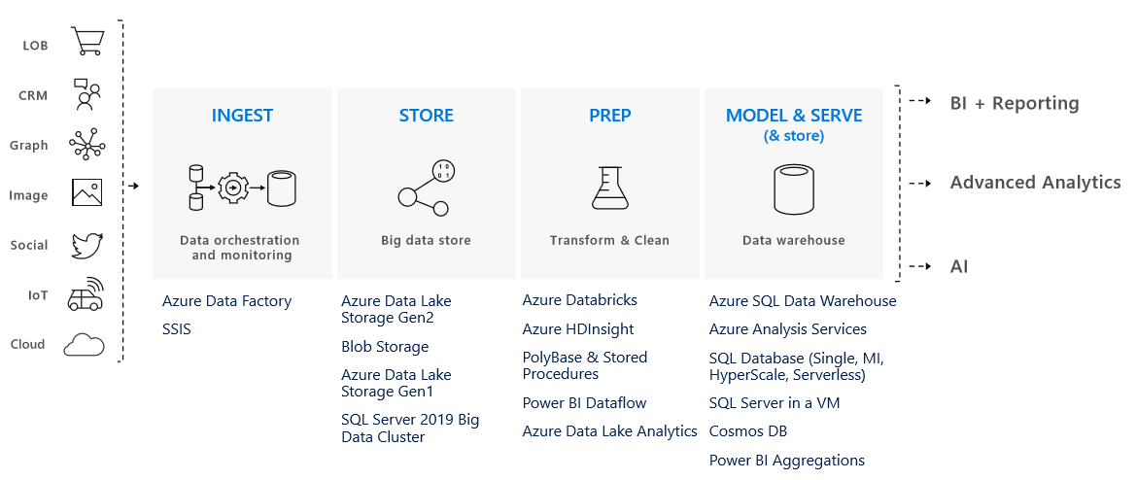
Delivering a Modern Data Warehouse with ADF

Slide 7
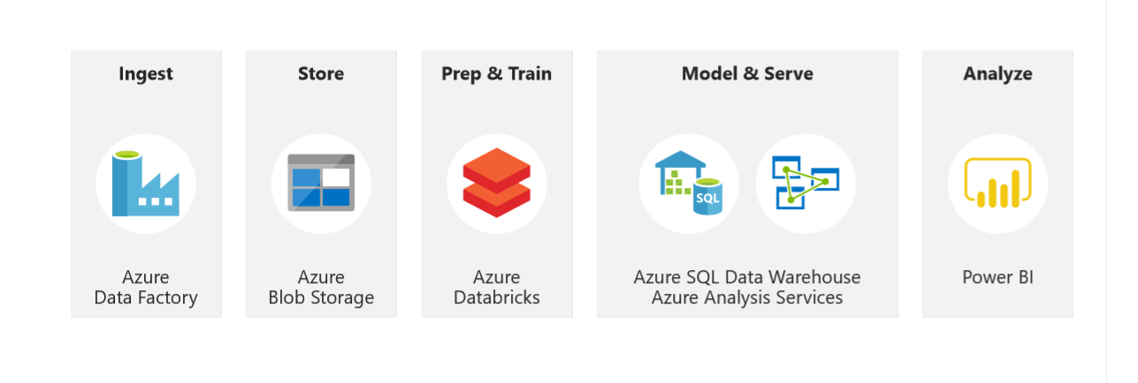
Demo
In this demo, I will show you how easy and quick it is to set up a modern data warehouse using Azure Data Factory. The architecture which we are going to create are displayed in the figure below.

Slide 8
Appendix

Slide 9
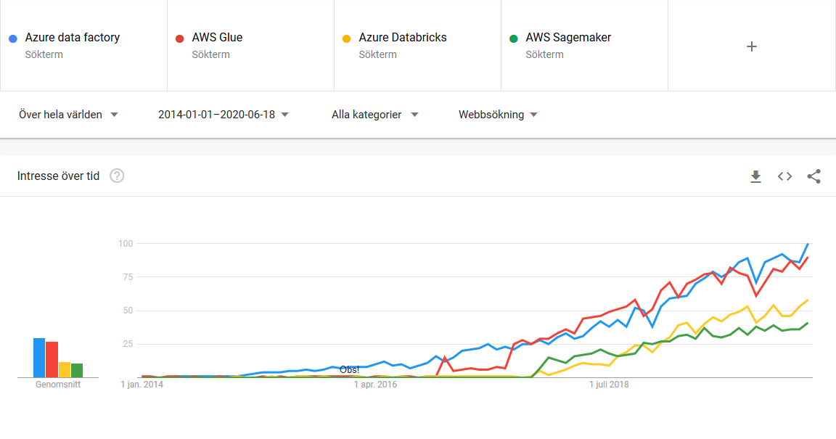
Google Trends

